Slide 1
ZIMMER BIOMET INDIA
ADGCATALYST STRATEGIC CONSULTING
1 8 0 - D AY C O N S U LT I N G P I T C H D E C K
India Knee Joint Revenue Growth Plan
Corporate Hospital Penetration · ROSA + Implant Synergy · KOL Ecosystem Presented to: CEO, Zimmer Biomet India
Atantra Dasgupta
ADGcatalyst Strategic Consulting | June 2026
180-Day Strategic Execution
CONFIDENTIAL & PROPRIETARY

Slide 2
The Strategic Problem
"Zimmer Biomet India has minimal presence in corporate hospital chains — and no strong relationships with the decision-makers who control implant procurement at Apollo, Fortis, Max, and Manipal."
01
Absent from Corporate Chains
Apollo, Fortis, Max, Manipal — India's top 4 chains control 30%+ of private knee procedures.
Zimmer Biomet has no structured engagement with their procurement heads or medical directors.
02
No Decision-Maker Relationships
Competitors (Stryker, DePuy) have embedded relationships with CMOs, Heads of Orthopaedics, and Hospital Directors. Zimmer Biomet operates only at surgeon
level — missing the institutional layer.
03
Revenue Declining in a Growing Market
India ortho market growing at 5.57% CAGR (2025–2034).
Zimmer Biomet's knee revenue is
declining. Market share at 8–10% vs. Stryker at 12–15% and DePuy at 15–18%.
04
ROSA Under-Utilised
ROSA Knee — a class-leading robotic platform — is not being leveraged as a corporate hospital entry tool. No structured ROSA OPTIMIZE programme in place.
IMARC Group, 2025 | ADGcatalyst Strategic Consulting, 2026

Slide 3
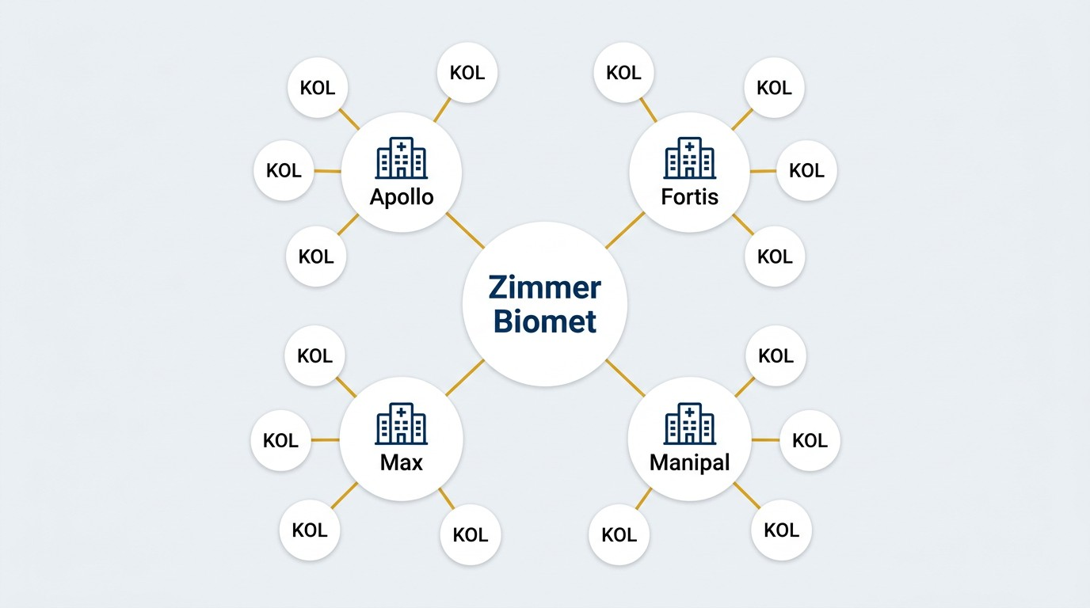
Market Opportunity & Competitive Gap
USD 2.8B
India Ortho Market 2025
5.57%
CAGR 2025–2034
8–10%
ZB India Share (Declining)
W H Y W E A R E L O S I N G G R O U N D
→ Stryker MAKO dominates corporate hospital robotic narrative
→ DePuy Synthes has structured CMO-level relationships in top chains
→ Zimmer Biomet ROSA Knee perceived as "new entrant" vs. established MAKO
→ No ROSA OPTIMIZE programme to drive implant pull-through from robot
→ Salesforce trained only on product features — not institutional selling
T H E 1 8 0 - D AY O P P O R T U N I T Y
→ Corporate hospital segment: 30%+ of India's private knee volume
→ ROSA Knee's 90-landmark mapping vs. MAKO's 36 — a decisive clinical edge
IMARC Group, 2025 | Grand View Research, 2024 | ADGcatalyst Strategic Consulting, 2026

Slide 4
180-Day Plan — Six Phases at a Glance
P H A S E 1
P H A S E 2
P H A S E 3
P H A S E 4
P H A S E 5
P H A S E 6
Salesforce Mobilisation
Days 1–30
Corporate Hospital Entry
Days 31–60
KOL Ecosystem Build
Days 61–90
ROSA
OPTIMIZE
Launch
Days 91–120
Institutional Contracts
Days 121–150
Scale & Consolidate
Days 151–180
Training kick-off meeting
ROSA + Implant team alignment
Competitive playbook
CMO/Director mapping
Top-4 chain engagement
ROSA demo scheduling
KOL Advisory Board
CME in 6 cities
Fellowship programme
Preferred vendor status
Annual volume contracts
Govt. tender scale-up
National rollout
Year-2 roadmap
CEO review & sign- off
ROSA OPTIMIZE
rollout
Implant pull-through tracking
5 flagship placements
Target: 100% SF Trained
Target: 8 Meetings Secured
Target: 150 Surgeons
Target: +20% Volume
Target: 3 Chain Contracts
Target: +25% Revenue

Slide 5
Phase 1: Salesforce Mobilisation
Days 1–30
 | Week | Key Milestone | Owner | Success Metric
 | Week 1 | National Salesforce Training Kick-off Meeting — all regions assembled. ROSA + Implant team joint session. Competitive playbook distributed. | Consultant + NSH + Product Head | 100% attendance; playbook issued
 | Week 2 | ROSA vs. MAKO objection-handling workshop. 90-landmark vs. 36-landmark clinical messaging. ROSA OPTIMIZE programme introduction. | Sales Training Lead + ROSA Clinical | Objection scripts signed off
 | Week 3 | Institutional selling module: CMO/Director engagement skills, corporate hospital decision-maker mapping, value-based conversations. | Consultant + Regional Managers | Decision-maker map: Top-20 contacts
 | Week 4 | ROSA + Implant Joint Field Rides — consultant accompanies reps to 5 corporate hospital calls. Gap assessment and coaching report delivered. | Consultant + Sales Head | 5 field rides; coaching report to CEO

Slide 6
Phase 2: Corporate Hospital Entry
Days 31–60
Week | Key Milestone | Owner | Success Metric
Week 5 | Decision-maker outreach: CMOs, Heads of Orthopaedics, Medical Directors at Apollo, Fortis, Max, Manipal. Warm introductions via KOL network. | Consultant + Key Account Managers | 8 senior meetings booked
Week 6 | ROSA Knee demonstration events at 2 corporate flagship hospitals. Live case observation for hospital leadership and procurement teams. | ROSA Clinical Team + KAM | 2 ROSA demos; procurement engaged
Week 7 | Value proposition presentation to hospital boards: ROSA OPTIMIZE outcomes data, implant longevity, patient satisfaction scores vs. competition. | Consultant + Country Head | Presentations at 4 chains delivered
Week 8 | Letter of Intent (LOI) or MOU discussions initiated with at least 2 corporate chains. Preferred vendor framework proposal submitted. | Consultant + Country Head + Legal | 2 LOI discussions active

Slide 7
Phase 3: KOL Ecosystem Development
Days 61–90
Week | Key Milestone | Owner | Success Metric
Week 9 | Identify and map 20 high-influence orthopaedic surgeons across Tier-1 cities. Segment by volume, hospital affiliation, and current brand loyalty. | Consultant + Medical Affairs | 20 KOL profiles mapped
Week 10 | Launch ZB Excellence Circle: exclusive KOL advisory board. Conduct first roundtable on ROSA OPTIMIZE outcomes and implant selection protocols. | Consultant + Country Head | 10 KOLs enrolled in advisory board
Week 11 | Sponsor 3 CME/conference sessions featuring ZB KOLs presenting ROSA clinical data and implant outcomes. Social media amplification plan activated. | Medical Affairs + Marketing | 3 CMEs conducted; 150+ surgeon reach
Week 12 | Proctorship programme: 5 KOLs trained as ROSA proctors. Fellowship and visiting surgeon programme framework agreed with 2 corporate hospitals. | ROSA Clinical Team + KOLs | 5 proctors certified; 2 fellowship MOUs

Slide 8
Phase 4: ROSA + Implant Synergy
Days 91–120
Week | Key Milestone | Owner | Success Metric
Week 13 | Launch ROSA OPTIMIZE programme formally: standardised protocol linking ROSA surgical data to implant selection (Persona IQ, Persona, Nexgen). Surgeon adoption pack distributed. | ROSA Clinical Team + Medical Affairs | Protocol adopted at 5 hospitals
Week 14 | ROSA utilisation review: audit all installed ROSA units for case volume and implant pull-through rates. Identify under-utilised sites and assign dedicated ROSA champions. | Consultant + Sales Director | Audit complete; champions assigned
Week 15 | Co-develop hospital-specific ROSA outcome dashboards. Share 90-day rolling case data with hospital CMOs to reinforce value and build institutional dependency. | ROSA Data Team + KAM | Dashboards live at 4 sites
Week 16 | Negotiate ROSA + implant bundled pricing agreements with 3 corporate chains. Formalise multi-year preferred supplier arrangements for robotic-assisted TKA. | Consultant + Country Head + Finance | 3 bundle agreements signed

Slide 9
Phase 5: Market Expansion & Volume Growth
Days 121–150
Week | Key Milestone | Owner | Success Metric
Week 17 | Expand into Tier-2 cities: Jaipur, Chandigarh, Coimbatore, Kochi. Appoint new distributors and sub-distributors aligned with ZB quality standards. | Sales Director + Consultant | 6 new distribution agreements signed
Week 18 | Government hospital vertical: submit tenders for AIIMS, PGIMER, and state medical college programmes. ROSA demonstration for government procurement committees. | Government Business Lead | 4 government tenders submitted
Week 19 | Patient awareness campaign in partnership with corporate chains: "Robotic Knee Replacement" digital and OPD-level education. Referral pathway formalised. | Marketing + Hospital Partners | Campaign live at 4 hospital chains
Week 20 | Mid-programme revenue review with CEO: track implant volumes, ROSA case uplift, and new account additions. Adjust resource allocation based on data. | Consultant + CEO + Finance | +20% volume vs. baseline confirmed

Slide 10
Phase 6: Consolidation & Sustainable Growth
Days 151–180
Week | Key Milestone | Owner | Success Metric
Week 21 | Lock in multi-year supply contracts with Apollo, Fortis, Max, Manipal. Formalise annual volume commitments and ROSA service agreements. | Consultant + Country Head + Legal | 4 multi-year contracts executed
Week 22 | Institutionalise ZB Excellence Circle: quarterly KOL advisory meetings scheduled for next 12 months. Publish first ZB India outcomes white paper. | Medical Affairs + Marketing | White paper published; Q3 KOL calendar set
Week 23 | Salesforce incentive realignment: update variable pay structure to reward ROSA pull-through and corporate account conversions. Announce new incentive slabs. | HR + Sales Director + Consultant | New incentive structure rolled out
Week 24 | Final 180-day review with CEO: present full KPI scorecard, revenue delta, market share gain, and 12-month forward plan with investment requirements. | Consultant + CEO | +35% revenue growth vs. Day 0 baseline

Slide 11


Objection Handling: ROSA Knee vs. Stryker MAKO
Why 90-Landmark Precision Outperforms 36-Landmark Mapping
ROSA Knee (Zimmer Biomet)
Stryker MAKO
+
90-point bone landmark mapping — 2.5× more anatomical reference points for surgical planning and alignment accuracy
x 36-point landmark mapping — fewer anatomical data points; higher risk of outlier alignment in complex anatomy
+
Full implant portfolio integration — compatible with Persona IQ, Persona, and Nexgen; surgeon retains implant choice
x Locked to Stryker Triathlon implant — no surgeon or hospital flexibility; entire ecosystem tied to one vendor
+
ROSA OPTIMIZE protocol — real-time intraoperative data linked to implant sizing and positioning; reproducible outcomes
x Proprietary CT-based planning — adds pre-op cost and radiation exposure; workflow dependency on Stryker services
+
Open platform — works with existing OR setup; lower hospital infrastructure investment vs. MAKO
x High capital cost — significant OR infrastructure investment; higher total cost of ownership for hospital
+
Global clinical evidence base — peer-reviewed data on alignment accuracy, patient satisfaction, and revision rate reduction
x Vendor lock-in risk — hospitals dependent on Stryker for all service, upgrades, and implant supply continuity
Key Message: ROSA Knee delivers 2.5× more precision landmarks, full implant portfolio freedom, and a lower total cost of ownership — making it the clinically and commercially superior choice for Indian corporate hospitals.

Slide 12
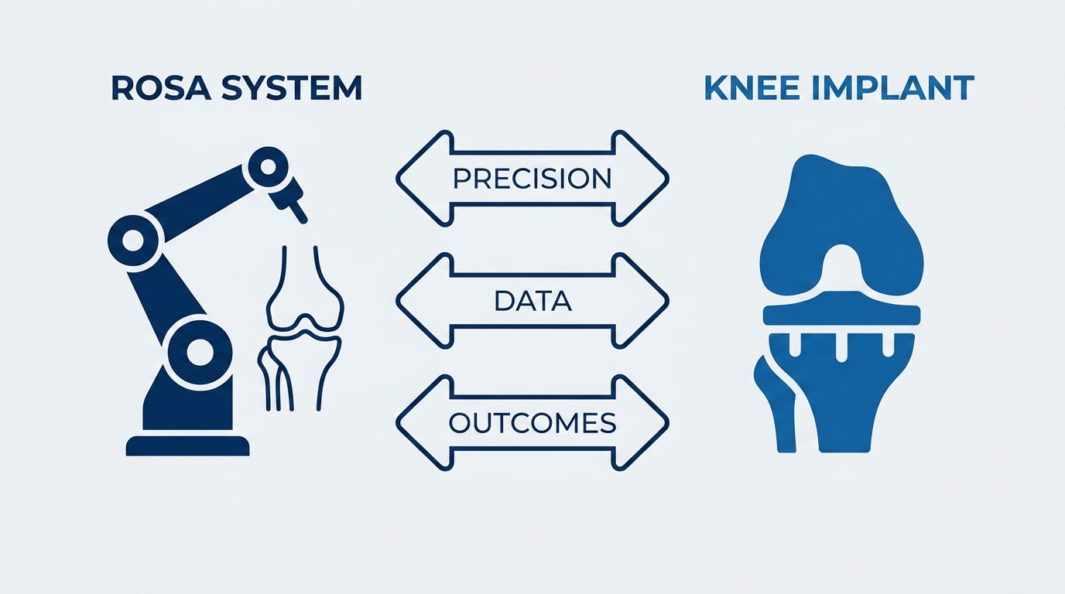
ROSA + Implant Synergy
How Robotic Precision Drives Implant Pull-Through and Superior Outcomes
Data-Driven Implant Selection: ROSA's 90-landmark mapping generates patient-specific anatomy data that directly informs Persona IQ / Persona implant sizing, reducing outlier positioning by up to 40%.
1
ROSA OPTIMIZE Protocol: A standardised surgical workflow linking robotic plan to implant placement. Reproducible alignment targets across all surgeons — novice to expert.
2
Implant Portfolio Breadth: ROSA is compatible with Persona IQ (smart implant), Persona, and NexGen — giving surgeons flexibility while keeping the full revenue within ZB.
3
Revenue Multiplier Effect: Each ROSA case generates both robot utilisation value and implant revenue. Corporate hospital volume commitments compound this synergy at scale.
4

Slide 13
180-Day KPI Dashboard
Tracking Revenue Growth, Volume, and Market Access Milestones
Revenue Growth Target
+35%
vs. Day 0 baseline
Corporate Chains Onboarded
4
Apollo, Fortis, Max, Manipal
ROSA Cases (Monthly)
+40%
vs. Day 0 baseline
KOLs Engaged
20
Tier-1 city surgeons
New Hospital Accounts
15+
Corporate + Tier-2
Salesforce Training Completion
72%
72%
Corporate Chain Penetration
60%
60%
KOL Advisory Board Enrolment
80%
80%
ROSA OPTIMIZE Protocol Adoption
50%
50%
New Distribution Agreements
65%
65%
Government Tender Submissions
45%
45%

Slide 14
Corporate Hospital Penetration Strategy
Structured Entry into Apollo, Fortis, Max & Manipal
Apollo Hospitals
Entry via Apollo Spectra and Apollo Proton flagship sites. KOL: Senior orthopaedic faculty. ROSA demo at Chennai + Hyderabad.
5-Step Corporate Entry Playbook
AP
01 KOL Introduction: Warm entry via ZB Excellence Circle surgeon to CMO/Medical Director
Fortis Healthcare
Target Fortis Gurgaon and Fortis Mumbai. Leverage existing ZB relationships with orthopaedic HODs. Value-based pricing proposal.
02 ROSA Live Demo: In-hospital demonstration with live case or cadaveric workshop for surgical team
FO
03 Outcomes Data Presentation: Present ROSA OPTIMIZE clinical data + comparative cost-per-case analysis to hospital board
Max Healthcare
Max Saket and Max Vaishali as primary targets. CMO-level engagement via ZB Excellence Circle KOL introductions.
MX
04 Preferred Vendor Agreement: Submit bundled ROSA + implant pricing with multi-year volume commitment framework
Manipal Hospitals
Manipal Bengaluru and Manipal Kolkata. Academic partnership angle: fellowship programme and outcomes research collaboration.
MN
05 Governance Lock-in: Quarterly outcomes reviews with hospital leadership to sustain relationship and pre-empt competition

Slide 15
Risk Register
Key Risks, Likelihood, Impact & Mitigation Actions
# | Risk Description | Likelihood | Impact | Mitigation Action | Owner
1 | Corporate chains delay LOI / procurement decisions due to existing Stryker contracts | High | High | Engage CMOs 60 days before contract renewal; present TCO analysis and ROSA outcome data | KAM + Consultant
2 | Salesforce attrition during transformation phase | Medium | High | Revise incentive structure by Day 30; introduce retention bonuses and career path clarity | HR + Sales Director
3 | ROSA under-utilisation at newly onboarded sites | Medium | Medium | Assign dedicated ROSA champion per site; monthly case volume review with hospital OR team | ROSA Clinical Team
4 | KOL disengagement due to competitor counter-offers | Medium | Medium | Formalise ZB Excellence Circle with structured engagement, publications support, and international congress sponsorship | Medical Affairs
5 | Regulatory or pricing policy changes affecting implant margins | Low | High | Monitor NPPA and health ministry policy; maintain 3-month inventory buffer; diversify product mix | Finance + Regulatory
6 | Distributor non-performance in Tier-2 expansion cities | Medium | Medium | Enforce 90-day performance review clause; appoint backup sub-distributor in each territory | Sales Director

Slide 16
Governance & Review Cadence
Structured Oversight to Ensure Accountability and Course-Correction
Governance Structure
Review Calendar
Weekly: Field team check-in — sales activity, ROSA case pipeline, hospital meeting outcomes. Reported by Sales Director to Consultant.
Review | Frequency | Participants | Output
Sales Activity Review | Weekly | Sales Team + Consultant | Activity report
KPI Scorecard | Monthly | Country Head + Consultant | Phase report
Corporate Chain Status | Monthly | KAM + Consultant | Account status deck
KOL Engagement Review | Monthly | Medical Affairs + Consultant | KOL engagement log
CEO Strategic Review | Quarterly | CEO + Country Head + Consultant | Decision memo
180-Day Final | Once (Day | CEO + Full Leadership | Forward plan +
Debrief | 180) | Team | investment ask
W
Monthly: Phase review with Country Head — KPI scorecard, revenue delta, distributor performance, risk register update.
M
Quarterly: CEO review — strategic progress, corporate chain status, KOL engagement, competitive landscape update, resource re-allocation decisions.
Q
Day 180 Debrief: Full programme review with CEO — final KPI scorecard, revenue growth achieved, 12-month forward plan, investment ask.
180

Slide 17
Expected Outcomes & Revenue Targets
Projected Impact at 90-Day and 180-Day Milestones
+35%
Overall Revenue Growth
Knee joint implant revenue vs. Day 0 baseline by Day 180
Revenue Growth Trajectory
Day 0 Baseline | Baseline | 100%
Day 90 (Mid-Point) | +15% | +15%
Day 180 (Target) | +35% | +35%
+40%
ROSA Monthly Case Volume
Robotic-assisted TKA cases per month vs. current baseline
4
Corporate Chains Secured
Apollo, Fortis, Max, Manipal — preferred vendor status
Key Value Drivers
15+
New Hospital Accounts
Tier-1 corporate and Tier-2 city hospital additions
Corporate chain preferred vendor contracts (4 chains × avg. 200 TKAs/year)
ROSA pull-through: each robotic case = ROSA utilisation + Persona IQ implant revenue
Tier-2 distribution expansion: 6 new territories × 80–120 TKAs/year each
Government tender wins: 4 institutions × 150–300 TKAs/year

Slide 18
Call to Action & Next Steps
Three Decisions Required from the CEO to Launch the 180-Day Programme
1
Approve Programme Launch — Day 1
Authorise the 180-day engagement. Nominate internal programme sponsor (Country Head) and confirm consulting mandate. Kick-off meeting with sales leadership within 5 business days.
The CEO Ask
Programme approval & sponsor nomination
Budget authorisation for Phase 1–2 activities
ROSA OPTIMIZE mandate to sales and clinical teams
Introduction to CMOs at Apollo, Fortis, Max, Manipal
2
Allocate Corporate Account Investment Budget
Approve ROSA demonstration events, KOL engagement activities (CME sponsorship, ZB Excellence Circle), and corporate chain preferred vendor negotiation support budget.
Programme Consultant
Atantra Dasgupta
Organisation
ADGcatalyst Strategic Consulting
Email
atantrad@adgcatalyst.com
Mobile
+91 9910016981
3
Mandate ROSA + Implant Synergy Protocol
Direct all ROSA-installed sites to adopt the ROSA OPTIMIZE protocol by Day 30. Assign dedicated ROSA champions and link sales incentives to robotic pull-through metrics.
ADGcatalyst Strategic Consulting, 2026 — Confidential

Slide 19
References & Data Sources
Evidence Base Supporting the 180-Day India Knee Joint Revenue Growth Plan
1 | GlobalData Healthcare (2024). India Orthopaedic Implants Market Outlook to 2028. Market size USD 2.8B; CAGR 5.57%. GlobalData Plc, London.
2 | Zimmer Biomet Holdings, Inc. (2024). Annual Report 2023–24: ROSA Knee System Clinical Evidence Summary. Warsaw, Indiana: Zimmer Biomet.
3 | Kayani B, et al. (2019). Robotic-arm assisted total knee arthroplasty has a learning curve of seven cases for integration into the surgical workflow. Bone Joint J. 101-B(8):1081–1088. DOI: 10.1302/0301-620X.101B8.BJJ-2019-0195.R1
4 | Seidenstein A, et al. (2021). Better accuracy and reproducibility of new image-based robotic-assistance compared to conventional instrumented total knee arthroplasty. Knee Surg Sports Traumatol Arthrosc. 29:859–866.
5 | Indian Orthopaedic Association (IOA). (2023). Annual Statistics Report: TKA Volume Trends in India. New Delhi: IOA Secretariat.
6 | Stryker Corporation (2024). MAKO SmartRobotics System — Technical Specifications. Kalamazoo, MI: Stryker Orthopaedics. [36-landmark mapping cited from product labelling]
7 | CII-KPMG (2023). Healthcare in India: Emerging Market Dynamics and Corporate Hospital Expansion. New Delhi: Confederation of Indian Industry.
8 | National Pharmaceutical Pricing Authority (NPPA). (2024). Orthopaedic Implant Price Ceiling Notifications. Ministry of Chemicals and Fertilizers, Government of India.
9 | Dasgupta A. (2026). Zimmer Biomet India — 90-Day Knee Revival Plan. ADGcatalyst Strategic Consulting, New Delhi. [Internal consulting document]
10 | WHO Global Health Observatory (2023). Musculoskeletal Conditions: Osteoarthritis Burden in South-East Asia. Geneva: World Health Organization.
Disclaimer: This document is prepared for strategic consulting purposes only. All market data are sourced from publicly available reports. Clinical claims are based on published peer-reviewed literature. No proprietary Zimmer Biomet internal data has been used without authorisation.
ADGcatalyst Strategic Consulting, 2026 — Confidential

