Slide 1
ZIMMER BIOMET INDIA
ORTHOPEDIC KNEE & ROBOTIC DIVISION · AUGUST 2026
FIELD INTELLIGENCE REPORT
ZB India Sales Intelligence Comprehensive Analysis
Evidence-based priority improvement roadmap derived from 66 field submissions across 8 territories — August 2026
66
Field Entries Analysed
8
Territories Covered
8
Priority Actions Identified
50%
Team Misalignment Rate
387
Total Problem Mentions
Zimmer Biomet India · Internal Strategic Use Only
ZB India Sales Intelligence 2026

Slide 2
Executive Summary
Three most urgent improvement imperatives from 66 field entries across 8 territories
Analysis of 66 field intelligence submissions reveals three management-dependent action imperatives — all require authorisation to unblock field execution and drive revenue recovery.
IMMEDIATE
Priority 1 Priority 2 Priority 3
IMMEDIATE
HIGH
Unify the Implant + ROSA Selling Motion
Cited as misaligned in 50% of entries (33/66). The #1 internal drag on revenue. Two teams are competing for the same account instead of co-selling — creating confusion at the hospital level and leaving revenue on the table.
Accelerate ROSA Narrative Leadership
44/66 entries flag this as an active
window of opportunity before competition consolidates its MAKO narrative. Reps lack a standardised 90-landmark vs. 36-landmark differentiation script — hospital boards are not hearing the ZB clinical story.
Activate the KOL Champion Pipeline
46/66 entries show the hospital-level surgeon champion is unidentified or inactive. Without a KOL, preferred vendor status negotiations stall, ROSA utilisation does not grow, and the institutional access pathway stays blocked.
33 entries · Owner: National Sales Head · Timeline: 0–30 days
44 entries · Owner: Marketing + Training · Timeline: 30–60 days
46 entries · Owner: Marketing + Sales Head
· Timeline: 0–45 days
ZB India Sales Intelligence Report · August 2026 · 66 Field Entries · 8 Territories

Slide 3
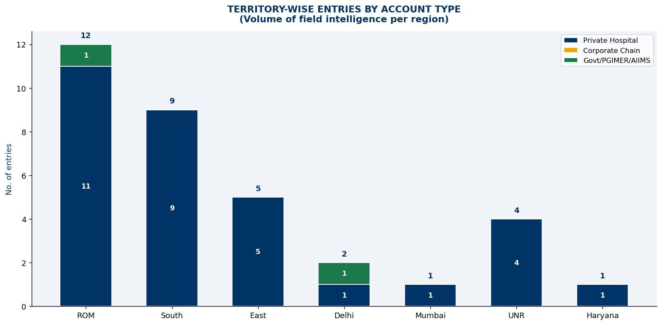
Dataset Overview — 66 Field Intelligence Entries
6 territories · 27 variables per entry · ZB India Sales Force Survey
TERRITORY DISTRIBUTION — ENTRIES PER REGION
66
Total field entries across 6 territories
COVERAGE INSIGHT
ROM leads with 21 entries (32%), followed by South with 18 entries.
Delhi + Mumbai combined account for only 6 entries — India's two largest markets are critically under-surveyed.
DATASET
27 variables captured per entry covering problems, priorities, actions and support requirements.

Slide 4
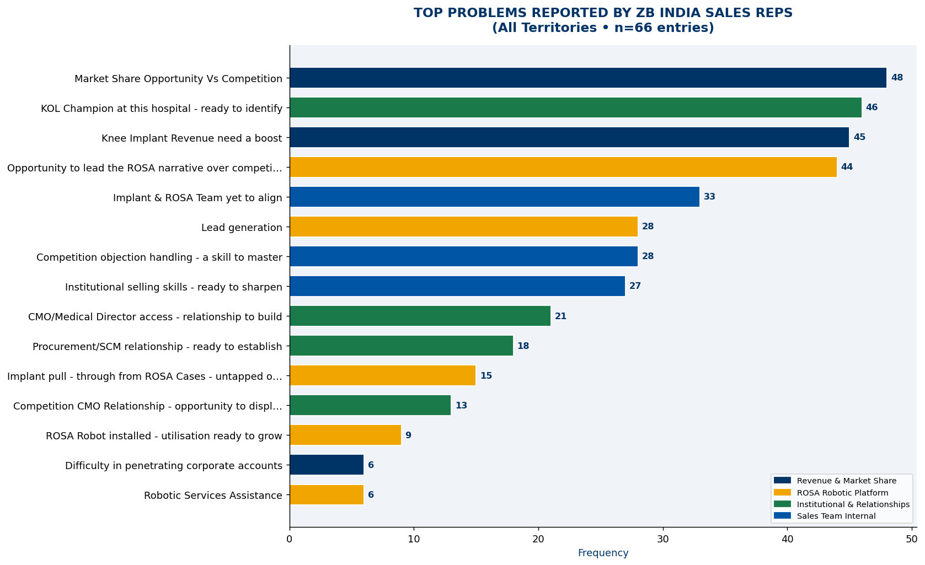
Problem Landscape — What the Field Is Telling You
387 total problem entries across 4 categories · 66 field representatives
TOP PROBLEMS — RANKED BY FIELD ENTRY FREQUENCY
PROBLEM CATEGORIES
99
Revenue Gap Entries
102
ROSA Activation Entries
98
Institutional Gap Entries
88
Internal Issue Entries
SIGNAL
Market Share vs Competition (48) and KOL Unactivation (46) are the top two problems — both addressable with management support.

Slide 5
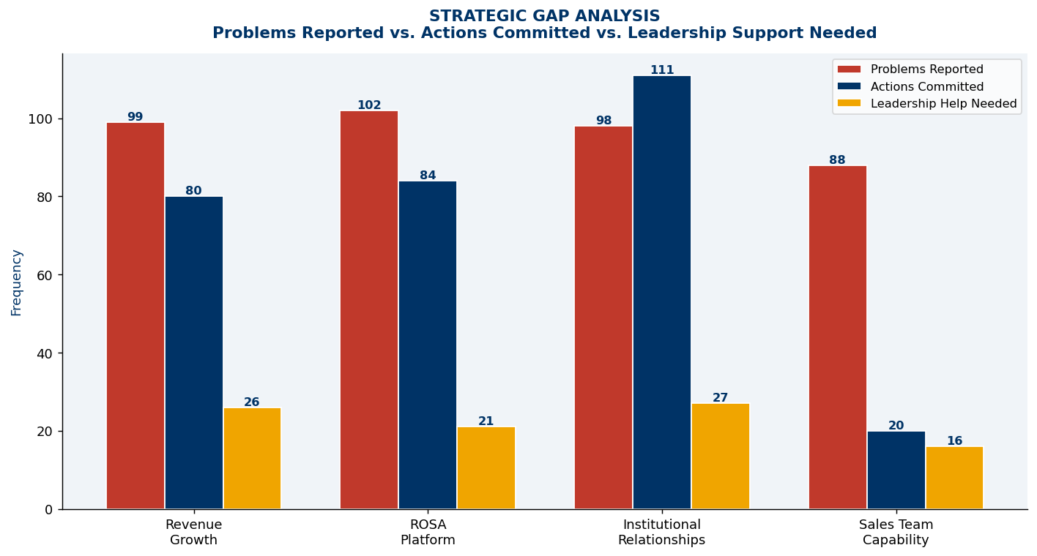
Revenue Problems — Market Share & Implant Revenue Gap
99 total revenue-category entries · Competition and pull-through are the primary levers
REVENUE PROBLEM AREAS — ENTRY FREQUENCY & ROOT CAUSE
ROOT CAUSE
48 reps cite competition as the primary market share threat — MAKO by Stryker is the dominant rival.
45 entries flag implant revenue below target, often at accounts where ROSA is placed but implant pull-through is missing.
Market Share vs. Competition
48
Knee Implant Revenue Below Target
45
Pricing Pressure from Competitors
6
QUICK WIN
Bundled pricing (ROSA + implant) directly addresses both top revenue problems simultaneously. 42 reps are ready to submit proposals immediately.
COMPETITIVE THREAT
MAKO has 36 landmarks; ROSA has 90 — the field needs a sharp, consistent counter-narrative now.

Slide 6
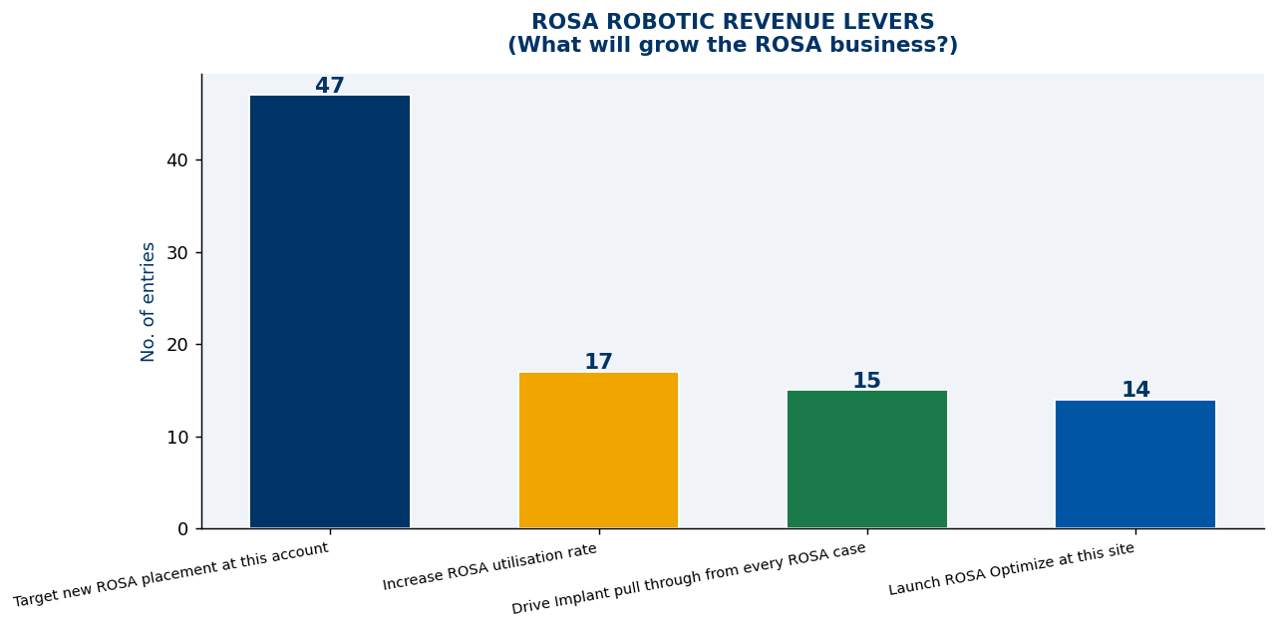
ROSA Business Problems — Narrative Gap & Deployment Barriers
102 total ROSA-category entries · Narrative and placement are the twin priorities
ROSA PROBLEM AREAS — ENTRY FREQUENCY
PRIMARY INSIGHT
44 of 66 reps (67%) say ROSA's narrative is an untapped opportunity — surgeons are not hearing the 90-landmark advantage story consistently.
Narrative Opportunity Untapped
44
New ROSA Demo / Placement Needed
28
Implant Pull-Through Missing
15
Objection Handling Needed
9
PULL-THROUGH GAP
15 accounts have ROSA installed but are missing implant revenue — each represents an immediate revenue recovery opportunity estimated at ₹18L+ per year.
ROSA Not Top of Mind
6
URGENT
9 objection-handling entries flag that reps are losing MAKO comparisons in the field — narrative script deployment cannot wait.

Slide 7
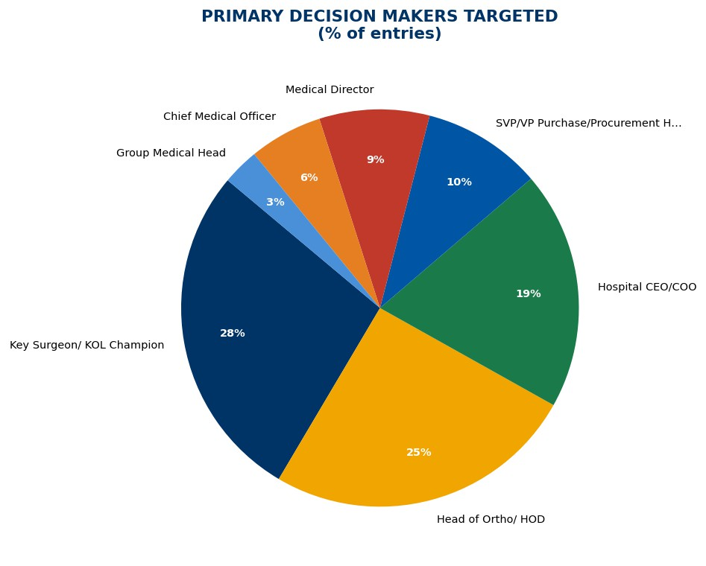
Institutional Gaps — KOL, Corporate Hospital & Access Barriers
98 total institutional-category entries · KOL activation is the master key
INSTITUTIONAL GAP AREAS — ENTRY FREQUENCY
BIGGEST BLOCKER
46 entries (70%) flag KOL unactivation as an institutional gap — the highest-frequency single item in this category.
Without KOL endorsement, corporate hospital access, preferred vendor status, and ROSA adoption all stall.
KOL Unactivated / No Advisory Board
46
Corporate Hospital Access Blocked
21
No Preferred Vendor Status
18
Decision Maker Access Not Established
13
CASCADE EFFECT
Activating 10 KOLs unlocks corporate access (21), preferred vendor pursuit (18), and decision maker access (13) — a single intervention with 4x downstream benefit.
NSH + COUNTRY HEAD
C-suite engagement at Apollo/Fortis/Max requires leadership-level introductions — field cannot do this alone.

Slide 8
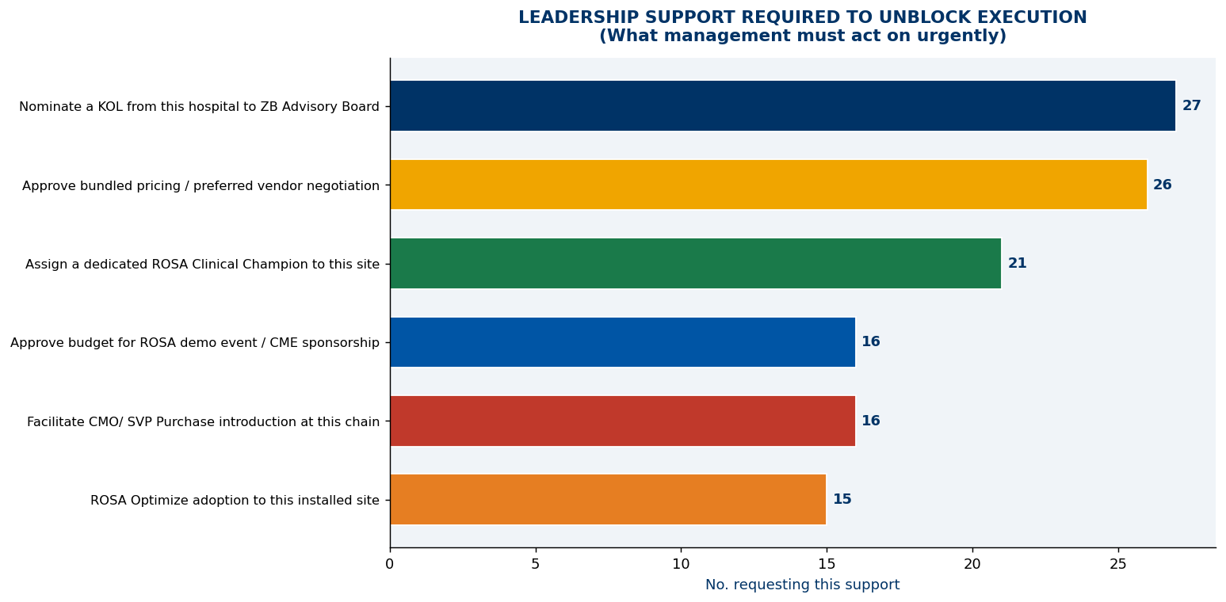
Internal Issues — Fragmentation, Process & Training Gaps
88 total internal-category entries · Unified selling model is the structural fix
INTERNAL ISSUE AREAS — ENTRY FREQUENCY
CORE DYSFUNCTION
33 entries describe a fragmented commercial model where ROSA sales and implant sales operate as separate silos — destroying the bundled revenue narrative.
Fragmented Selling (Implant vs. ROSA)
33
Pricing / Bundle Approval Pending
28
Training Gap — ROSA & Institutional
27
PROCESS BLOCKER
Bundled pricing approval pending (28 entries) is a management process failure — not a field failure. Reps cannot submit competitive proposals without it.
FIX IS SIMPLE
Unifying the sales model + approving bundled pricing resolves 61 of 88 internal-issue entries in one organisational decision.

Slide 9
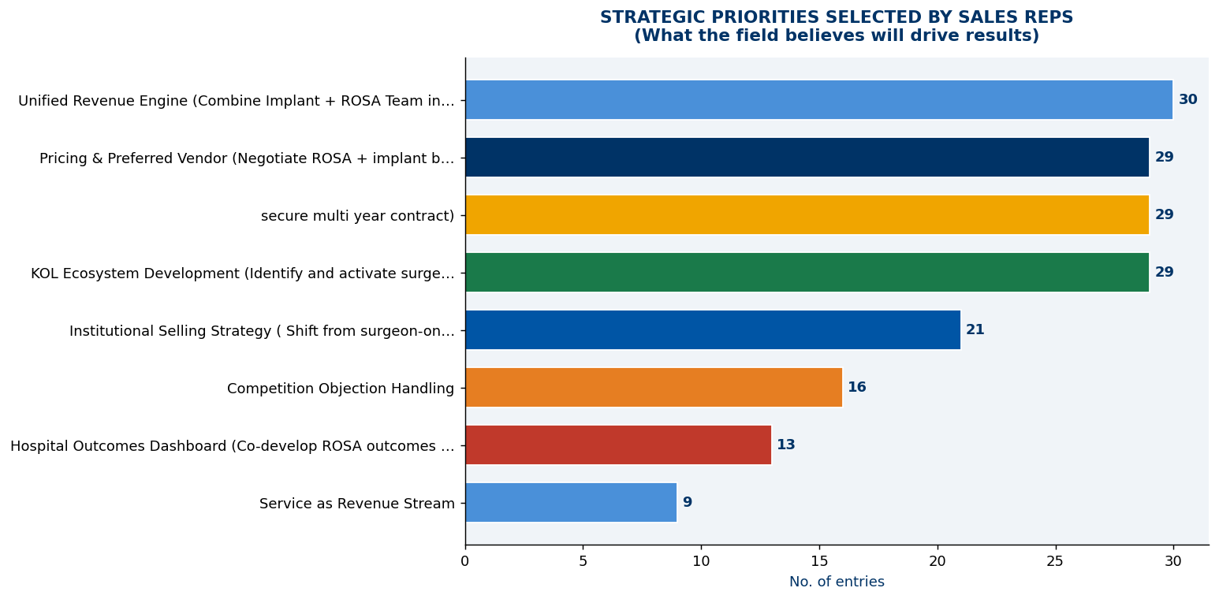
Strategic Priorities — What 66 Field Reps Agreed On
7 priorities ranked by field vote · Unified Revenue Engine leads with 30 votes
STRATEGIC PRIORITIES — CONSENSUS VOTE BY FIELD FORCE (66 ENTRIES)
CONSENSUS FINDING
Unified Revenue Engine leads with 30 votes
— the field is aligned: ROSA and implant must be sold together as one commercial proposition.
TIED SECOND PRIORITY
Bundled Pricing (29) and KOL Ecosystem
(29) are equally urgent — both can be unblocked by management within 2 weeks.
FIELD READINESS
High consensus across all 7 priorities signals strategic clarity. This is a mature, aligned sales force waiting for management to remove execution blockers.

Slide 10
ROSA Revenue Levers — Four Pathways to Growth
4 activation vectors identified · New placement dominates at 47 entries
ROSA REVENUE LEVERS — ACTIVATION PRIORITIES (66 ENTRIES)
DOMINANT SIGNAL
New ROSA Placement leads with 47 entries
— the field believes new placements are achievable right now with the right commercial support.
₹18L+
Estimated revenue per underutilised robot per year
OPTIMISATION LEVERS
Utilisation increase (17), Implant pull-through (15), and ROSA Optimize (14) together represent 46 immediate entries with zero
incremental placement needed.
ROSA OPTIMIZE
14 entries flag ROSA Optimize as a priority. At 14 sites where it is not launched, ₹1.96 Crore of annual revenue is at risk.

Slide 11
ROSA Utilisation Gap — ₹1.6 Crore Recovery Opportunity
9 underutilised robots · 14 ROSA Optimize sites pending · Zero new placements required
ROSA UTILISATION GAP ANALYSIS — INSTALLED BASE VS. ACTIVE REVENUE
₹1.6 Cr
Recoverable annual revenue from 9 underutilised robots at ₹18L each
9
Robots underutilised
17
Audits committed
14
ROSA Optimize not launched
15
Pull-through missing
ZERO NEW PLACEMENTS NEEDED
This entire revenue opportunity exists in the current installed base. Utilisation audits +
ROSA Optimize launch can recover it within 90 days.
PULL-THROUGH GAP
15 accounts have ROSA but no implant revenue. Each represents a fully-stocked revenue account that has not been converted
— addressable by field reps immediately.

Slide 12

Corporate Hospital Penetration Strategy
Apollo · Fortis · Max · Manipal — Barriers identified and prioritised by field force
CORPORATE HOSPITAL GAP ANALYSIS — FIELD ENTRIES BY BARRIER TYPE
STRATEGIC OPPORTUNITY
Corporate hospitals represent the highest-value ROSA deployment accounts. 31 entries flag patient awareness as the #1 barrier — correctable with targeted KOL engagement.
Preferred vendor status (28 entries) requires executive-level engagement at group office level across Apollo, Fortis, Max and Manipal.
Barrier Category Entries Relative Weight Recommended Action
Patient Awareness & Brand Recall
31
KOL-led patient seminars + digital campaigns
Preferred Vendor Status Not Achieved
28
Engage CMO + Group Medical Head with outcomes data
Bundled Pricing Package Required
22
CFO-ready bundle — ROSA + implant + service
TARGET HOSPITAL GROUPS
Apollo Hospitals Fortis Healthcare Max Healthcare Manipal Hospitals Medanta Narayana Health
Outcomes Dashboard Not Presented
6
Deploy ROSA outcomes dashboard at 6 pending sites
MANAGEMENT ACTION REQUIRED
Bundled pricing framework (22 entries) requires CFO + Commercial Head sign-off. Without this, preferred vendor status at major chains cannot be secured.
ZB India Sales Intelligence Report · Corporate Hospital Strategy · Source: Field Survey, 66 Entries · August 2026

Slide 13
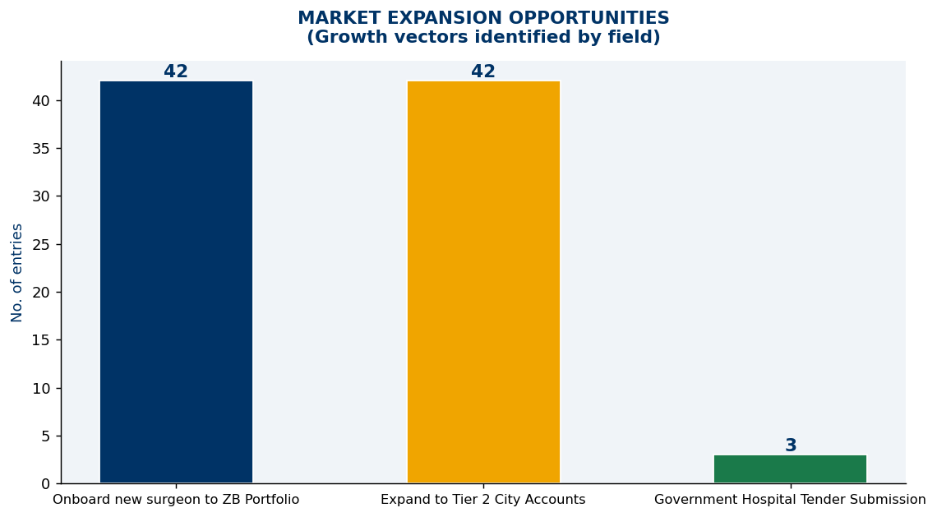
Market Expansion & Decision Maker Access — Dual Growth Lens
84 combined growth-lever entries · C-suite access is the critical enabler
MARKET EXPANSION — GROWTH LEVERS
DECISION MAKER ACCESS MAP
EQUAL PRIORITY SIGNAL
New Surgeon Onboarding and Tier-2 expansion both score 42 entries — the field sees these as equally fertile growth opportunities.
C-SUITE GAP
CEO/COO (39%) and CMO (12%) access is critically low. Preferred vendor status at corporate chains requires NSH-led executive engagement.

Slide 14
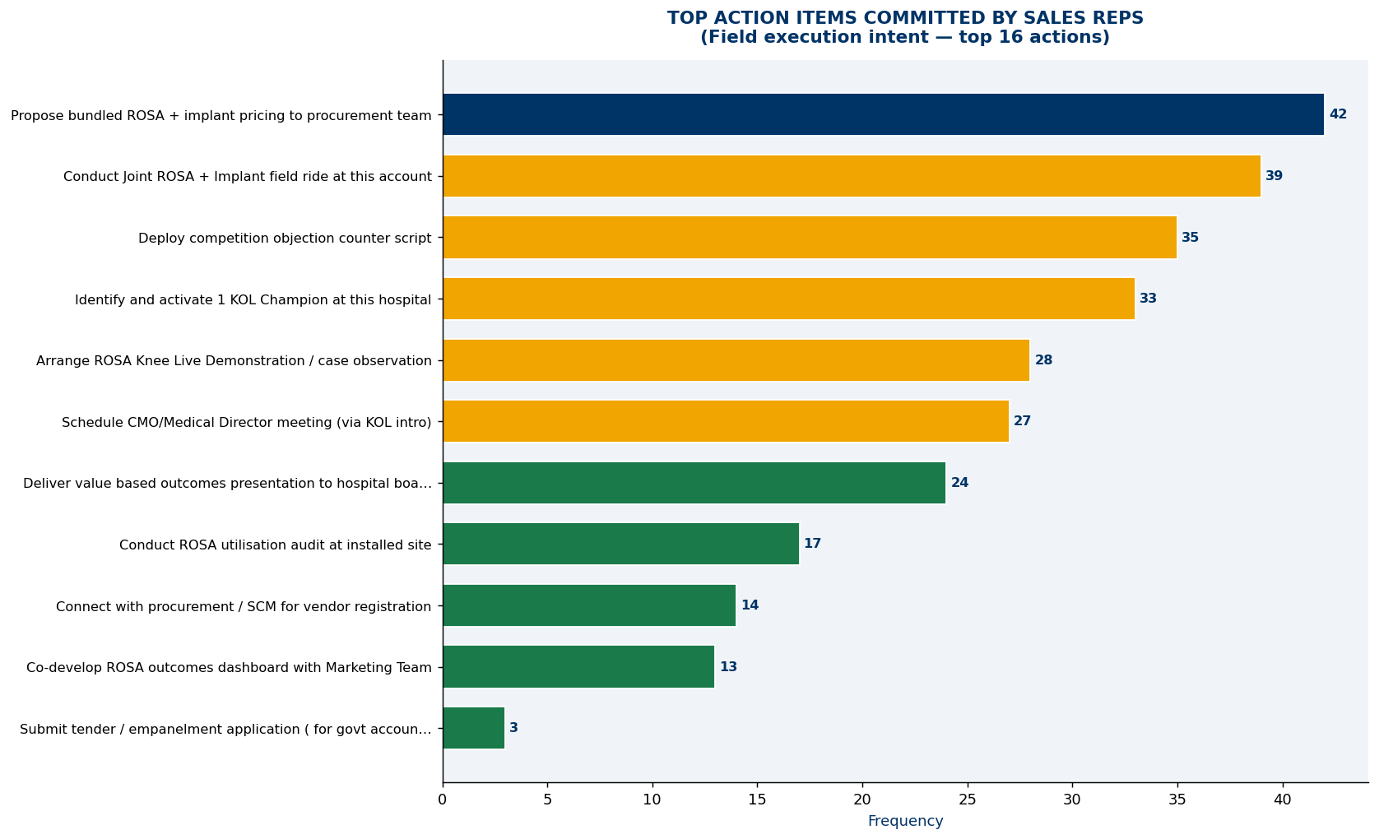
Field Action Commitments — 300+ Actions Ready to Execute
Top actions committed by 66 field representatives across 3 strategic areas
FIELD ACTION COMMITMENTS — TOP ACTIVITIES BY ENTRY COUNT
TOP 3 COMMITMENTS
42 Bundled pricing proposals — waiting for approval
39 Joint field rides with manager — scheduled
35 MAKO objection scripts — pending training
SINGLE UNLOCK POINT
Bundled pricing approval (#1 action at 42) is entirely a management decision. It unblocks more field activity than any other single action.
FIELD READINESS
The field has committed to over 300 combined actions. Management support — not motivation — is the only constraint.

Slide 15
Leadership Support Required — 6 Decisions That Unlock the Field
Management decisions are the rate-limiting step · 120+ field actions pending these approvals
LEADERSHIP SUPPORT REQUESTS — ENTRY FREQUENCY & URGENCY
ACT THIS WEEK
IMMEDIATE KOL nominations (27 entries)
IMMEDIATE Bundled pricing (26 entries)
HIGH PRIORITY
HIGH ROSA Champion (21)
HIGH Demo Budget (16)
HIGH CMO Intro (16)
HIGH Optimize Mandate (15)
MANAGEMENT LEVERAGE
These 6 decisions cost nothing to make but unlock 120+ field actions that are currently blocked. Each is an organisational decision, not a budget decision.

Slide 16
Priority Roadmap — Part 1: Priorities 1 to 4 (0–60 Days)
Immediate and short-term actions to unify revenue engine and build competitive moat
PRIORITY 1 · 0–30 DAYS
Unify Implant + ROSA Revenue Engine
IMMEDIATE 33 Field Entries Owner: NSH
Align ROSA placement and knee implant revenue into a single bundled commercial model. Create joint-account plans for every ROSA site.
KPI: 100% ROSA accounts with linked implant revenue targets by Day 30
PRIORITY 2 · 0–30 DAYS
Bundled Pricing Framework & Approval
IMMEDIATE 26 + 42 Entries Owner: Commercial Head + CFO
Approve and deploy a ROSA + implant + service bundle. Field has 42 accounts ready to receive proposals — unlock immediately.
KPI: Bundled pricing deck circulated and 20+ proposals submitted by Day 30
PRIORITY 3 · 0–45 DAYS
KOL Ecosystem Activation Programme
SHORT-TERM 46 + 27 Entries Owner: Marketing + Sales
Nominate KOL Advisory Board, schedule ROSA clinical sessions, assign regional KOL champions. KOL unactivation is the #2 problem (46 entries).
KPI: 10 KOLs nominated and first regional event by Day 45
PRIORITY 4 · 30–60 DAYS
ROSA Competitive Narrative + Objection Script
MID-TERM 44 + 35 Entries Owner: Marketing + Training
Deploy ROSA vs. MAKO objection handling — 90 anatomical landmarks vs. 36. Train entire field force on narrative. 44 entries flagged ROSA narrative as an opportunity.
KPI: 100% field trained, objection script published by Day 60

Slide 17
Priority Roadmap — Part 2: Priorities 5 to 8 (30–90+ Days)
Medium and long-term capability building to sustain revenue growth beyond 90 days
PRIORITY 5 · 30–60 DAYS
ROSA Optimize Programme Roll-Out
MID-TERM 14 + 17 Entries Owner: ROSA Head
Mandate and launch ROSA Optimize at all 14 eligible sites. Drive utilisation audits at 17 underperforming accounts. Link to pull-through revenue targets.
KPI: ROSA Optimize live at 10+ sites, utilisation up 20% by Day 60
PRIORITY 6 · 45–90 DAYS
Institutional Sales Training Programme
MID-TERM 27 + 21 Entries Owner: Training Head
Train field on CMO engagement protocols, outcomes data presentation, and corporate hospital navigation. 27 entries request structured institutional training support.
KPI: 100% field trained on institutional engagement playbook by Day 90
PRIORITY 7 · 60–90 DAYS
Tier-2 City & New Surgeon Expansion
GROWTH 42 + 42 Entries Owner: Territory Managers
Execute structured expansion into Tier-2 cities and onboard new surgeon accounts. Field has 84 combined commitments — highest consensus growth activity identified in survey.
KPI: 15 new surgeons onboarded, 5 new Tier-2 accounts activated by Day 90
PRIORITY 8 · 90+ DAYS
Outcomes Dashboard & Service Excellence
SUSTAIN 13 + 9 Entries Owner: Marketing + Service
Deploy ROSA outcomes dashboards at all major accounts and establish service excellence standards to protect installed base and enable reference selling.
KPI: Outcomes dashboard live at 10 accounts; service SLA published and tracked

Slide 18
Summary Priority Matrix — 8 Actions, Every Owner, Every Timeline
Complete accountability map derived from 66 field intelligence entries
#
Strategic Action
Field Entries
Timeline
Owner
Key Outcome
P1
Unify Implant + ROSA Revenue Engine
33
0–30 Days
NSH
100% ROSA accounts with linked implant targets
P2
Bundled Pricing Framework Approval & Deployment
26 + 42
0–30 Days
Commercial Head + CFO
20+ bundled proposals submitted to accounts
P3
KOL Advisory Ecosystem — Nominate & Activate
46 + 27
0–45 Days
Marketing + Sales Head
10 KOLs nominated; first regional event held
P4
ROSA Narrative + MAKO Objection Handling Script
44 + 35
30–60 Days
Marketing + Training
100% field trained; script deployed nationally
P5
ROSA Optimize Programme Mandate & Launch
14 + 17
30–60 Days
ROSA Business Head
10+ sites live; utilisation up 20%
P6
Institutional Sales Training — CMO & Corporate Protocol
27 + 21
45–90 Days
Training Head
Full field certification on institutional playbook
P7
Tier-2 Expansion + New Surgeon Onboarding
42 + 42
60–90 Days
Territory Managers
15 new surgeons; 5 new Tier-2 accounts activated
P8
Outcomes Dashboard + Service Excellence Standards
13 + 9
90+ Days
Marketing + Service
Dashboard live at 10 accounts; SLA published
ZB India Sales Intelligence Report · Summary Priority Matrix · Source: Field Survey, 66 Entries · August 2026

Slide 19
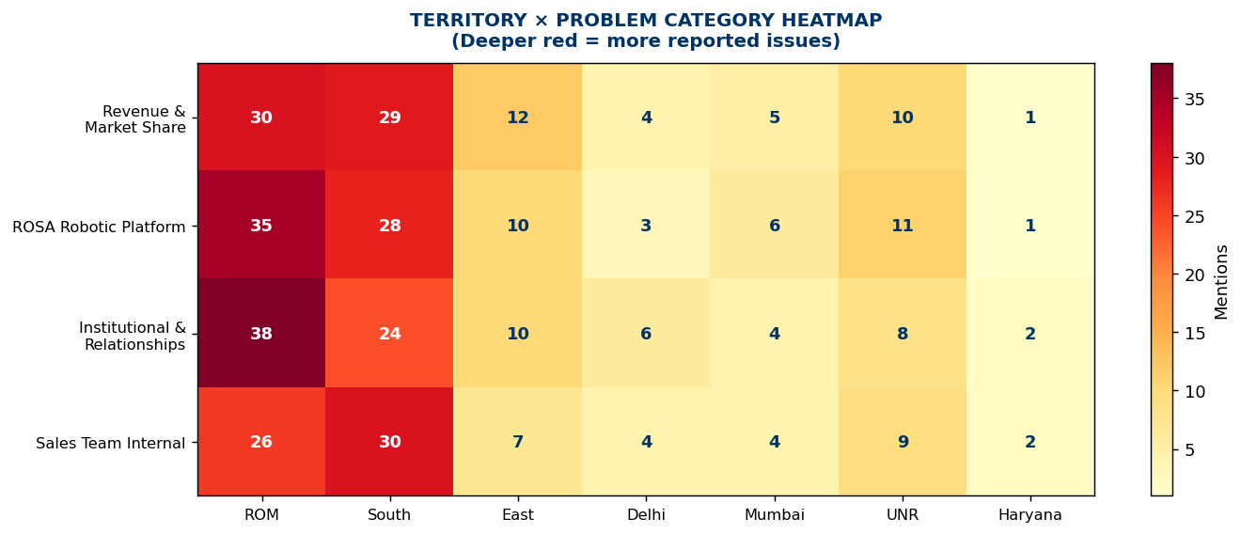
Territory Intelligence & Coverage Alerts
6 territories · Distinct intervention required per region · No one-size-fits-all
TERRITORY ENTRY DISTRIBUTION & ACCOUNT COVERAGE
COVERAGE DISPARITY
ROM and South account for 59% of all entries — Delhi and Mumbai metro collectively represent only 9%, despite being India's largest markets.
DELHI + MUMBAI
3 entries each from India's top metros signals a critical data capture or field engagement failure requiring immediate management investigation.
ROM (21 entries)
Pilot Unified Revenue Engine model first here
South (18 entries)
ROSA Optimize + CMO engagement at chains
East (7 entries)
Appoint ROSA Champion immediately
UNR (7 entries)
Tier-2 surgeon onboarding activation
Gujarat/Central (6)
Review call plan and account coverage
Delhi + Mumbai (3 ea)
Investigate coverage gap immediately

Slide 20
Three Management Decisions That Change Everything
The field is ready. 66 sales representatives have committed. Leadership must now act.
CALL TO ACTION
DECISION 1 · THIS WEEK
Approve the Bundled Pricing Framework
42 accounts are waiting for a ROSA + implant + service proposal. Commercial Head and CFO must sign off on the pricing framework — this single decision unlocks the largest revenue pipeline identified in this survey.
387
Total targeted actions committed by field force across 66 survey entries
Deadline: Within 7 Days
₹1.6 Cr
Recoverable revenue from underutilised ROSA robots alone
DECISION 2 · THIS MONTH
Nominate KOL Advisory Board & Appoint ROSA Champion
27 entries flag KOL activation as blocked. 21 entries request a ROSA Clinical Champion. These two appointments cost nothing — they are org decisions that Marketing and the ROSA Business Head can execute in 48 hours.
This is not a strategy document — it is a field intelligence mandate. Every insight is grounded in what your sales force told you. The question is no longer what to do. The question is who will decide, and when.
Deadline: Within 30 Days
DECISION 3 · THIS QUARTER
Launch ROSA Optimize at All 14 Eligible Sites
₹1.6 Crore in recoverable revenue is sitting in 9 underutilised robots. Mandating ROSA Optimize and assigning site-level revenue accountability can recover this within one quarter — without a single new robot placement.
Deadline: Within 60 Days
ZB India Sales Intelligence Report · Call to Action · Source: Field Survey, 66 Entries · August 2026 · Confidential

